Slide 1
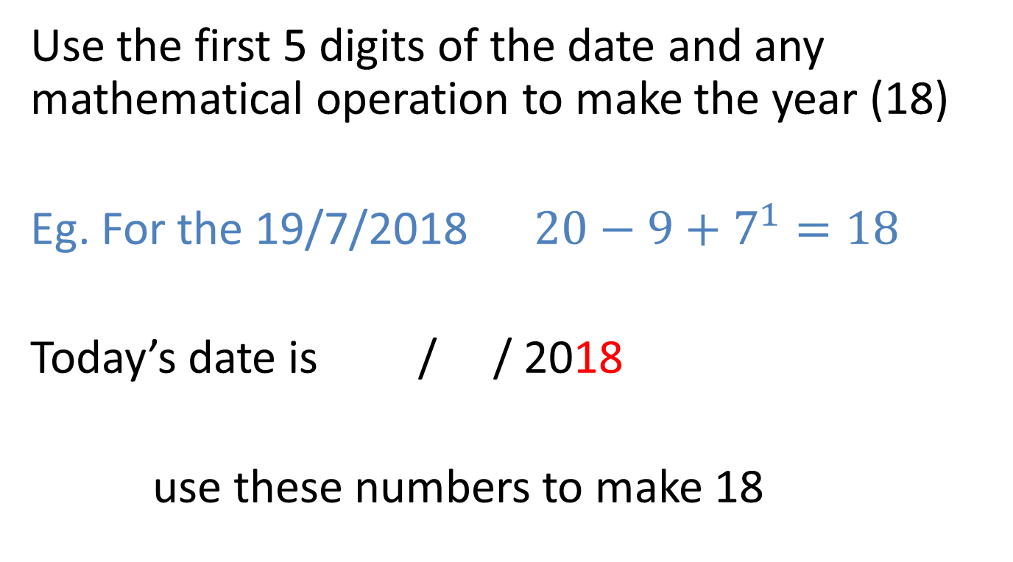
Who wants VIVOS
Use the first 5 digits of the date and any mathematical operation to make the year (18)
Eg. For the 19/7/2018 $20−9+7^{1}=18$
Today’s date is / / 2018
use these numbers to make 18
Notes:
hook

Slide 2
Lesson objective
By the end of this lesson you will be able to;
- Expand brackets using a model
Notes:
Lesson

Slide 3

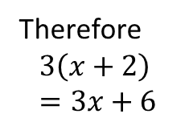
24
7
30
Date
Distributive law
EQ – How can we expand brackets?
Method 1:
Steps
Draw the boxes
Write the terms from the brackets on top
Write the term outside next to the boxes
Multiply the ___ with the ____
Multiply the ____ with the ____
Write your answer nicely
Expand $3\left(x+2\right)$
X 2
3
3x
6
Therefore
$$3\left(x+2\right) \\ =3x+6$$
5
Notes:
Lesson objective (EQ)

Slide 4


Date
24
7
30
Date
24
7
30
Distributive law
EQ –
How can we expand brackets?
Method 2:
Steps
Multiply the 5 with the x
Multiply the 5 with the ___
Bring the sign down
Write your answer nicely
Expand $5\left(x−2\right)$
$\left(x−2\right)$
$$5x − 10$$
$$5x−10$$
5
5
Notes:
Input

Slide 5
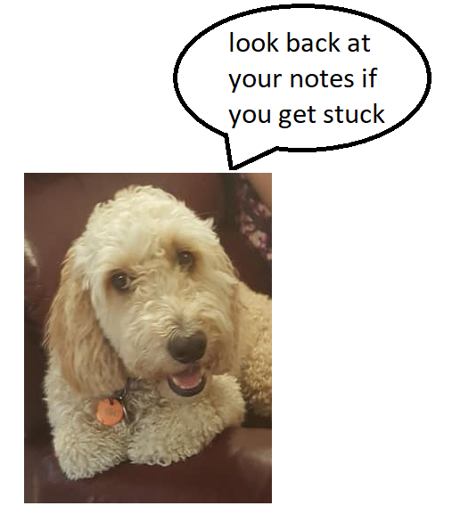
Try these (LHS)
Expand the following
4(d+2)
10(4 - s)
3(2x+7)
Notes:
Check for understanding

Slide 6
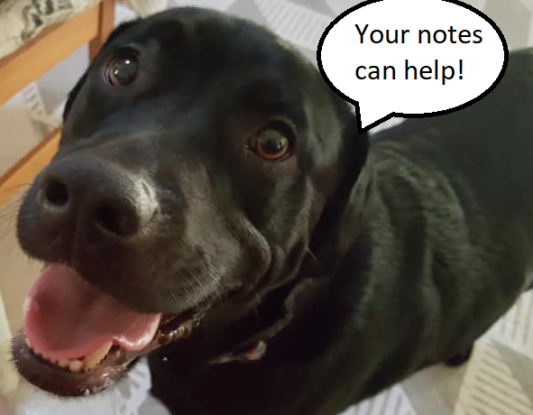
Pg 39 Dwyer book
Complete exercise 3.7
If you get stuck
Notes:
Independent practice

Slide 7
Sentence frame summary
Complete the sentences to make your summary
To expand brackets using the distributive law we___________
Notes:
Closure

Slide 8
Lesson 2 New day New date
Use the first 5 digits of the date and any mathematical operation to make the year (18)
Eg. For the 19/7/2018 $20−9+7^{1}=18$
Today’s date is / / 2018
use these numbers to make 18
Notes:
hook

Slide 9

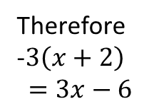
24
7
30
Date
Distributive law
EQ – How can we expand brackets when negatives are involved?
Method 1:
Steps
Expand $−3\left(x+2\right)$
X 2
-3
-3x
-6
Therefore
-$3\left(x+2\right)$ $$=3x−6$$
Notice the sign changes
5
Notes:
Lesson objective (EQ)

Slide 10


Date
24
7
30
Date
24
7
30
Distributive law
EQ –
– How can we expand brackets when negatives are involved?
Method 2:
Steps
Expand -$5\left(x−2\right)$
-5 $\left(x−2\right)$
$$−5x − −10$$
$$−5x+10$$
Be careful the sign changes!
5
5
Notes:
Input

Slide 11
Try these
Expand the following
-4(d+2)
-10(4 - s)
-3(2x+7)
Notes:
Check for understanding

Slide 12
Pg 40 Dwyer book
Complete exercise 3.9 and 3.10
Notes:
Independent practice

Slide 13
Sentence frame summary
Complete the sentences to make your summary
When expanding brackets that have negatives we have to be careful of___________
Notes:
Closure

